Slide 1

Group 3
Dirk Thieme, Erik Manis, & Mohammed Ansari

Slide 2
Last Week's Tasks
Get Admin Requirements complete
Motor Demo Project
Gantt Chart
Budget
Start Work
Watch Verilog Tutorials
Get software
Project notebook
Rover chassis
Soldering Tutorials

Slide 3
Completed Tasks
All: Admin requirements complete
Motor demo project
Dirk: Gantt chart
Mohammed: Budget
All: Software downloaded
Erik: Project notebook setup
Mohammed: Rover chassis

Slide 4
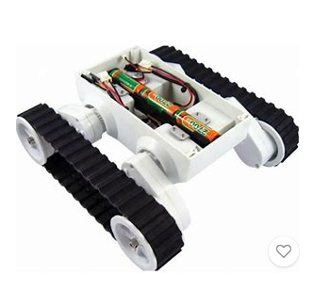
The Rover

Slide 5
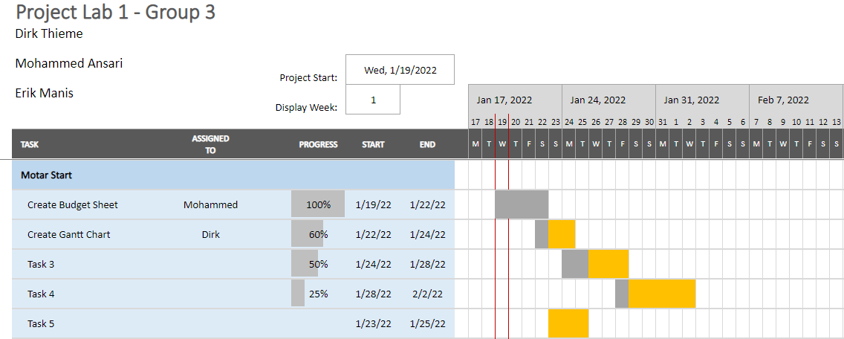
Gantt

Slide 6
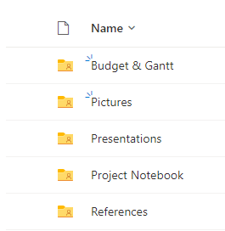
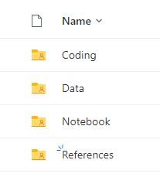
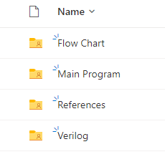
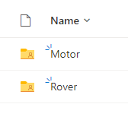
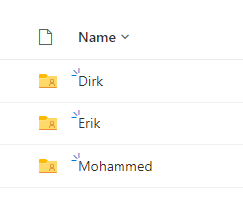
Project Notebook

Slide 7
Schedule Changes
Soldering tutorials
The classes for this are tomorrow and next week
Mohammed plans to attend tomorrow
Dirk and Erik plan to attend next week
Verilog tutorial Videos
None of us finished the videos
Starting work on the rover
We do not have the parts in our possession yet

Slide 8
Next Week's Tasks
Getting the parts in
Try putting parts together
Start programming for the motors

Slide 9
Budget Update
We have a budget?

Slide 10
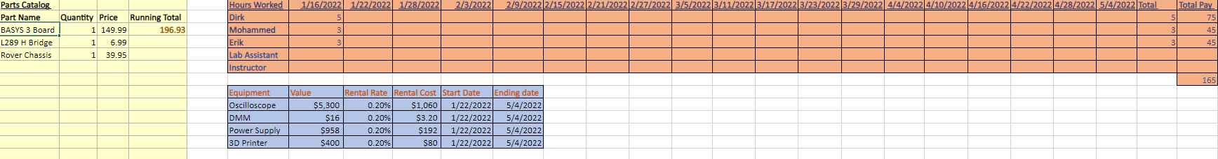
The Budget

Slide 11

Questions
Group 3
Dirk Thieme, Erik Manis Mohammed Ansari
This Photo by Unknown author is licensed under CC BY.

